Slide 1
Outpatient Center

Slide 2
West Baltimore Chronic Disease Profile and
Acute Care Utilization

Slide 3
Targeted West Baltimore Patient Population Requiring Care Delivery Transformation
Tier 3
High Risk
– Multiple Chronic
Condition
Patients
Tier 2
Rising Risk Patients
Tier 1
Low Risk Patients
Phase I
Most complex
patients with high acute care utilization and behavioral health support needs
Intervention
Intervention can reverse trend and improve health quality while reducing costs.
Need more support clinically, more behavioral health needs to address, chronic conditions not under control
Phase II
Less medically complex, greater social services needs and access to care (mental health; medical)

Slide 4
Rationale for Regional Centers of Clinical
Excellence for West Baltimore and Maryland:
Social and Clinical Determinants Contributing to Health of Community
West Baltimore and Maryland Statistics:
Many West Baltimore communities report >50% of households living below the poverty level
Per capita income 34.9% less than the average across Baltimore and majority of household incomes at or below $25k/yr
Several neighborhoods report unemployment rates between 20 to nearly 60%
Average life expectancy in Baltimore City is 12 years shorter than in Maryland and 20 years shorter in several Baltimore neighborhoods adjacent to UMMC
Cardiovascular disease is three times higher than many other Maryland communities
Staggering health disparities in diabetes, asthma, cancer, obesity, HIV, violence, hypertension, smoking and a host of other diseases

Slide 5
Rationale for Regional Centers of Clinical
Excellence for West Baltimore and Maryland:
Social and Clinical Determinants Contributing to Health of Community
Diabetes prevalence is 25-50% above the national average in West Baltimore and Maryland Counties.
Obesity in African American Adults is greater than 35% and is “off the charts” which is equivalently highest in the nation.
Asthma deaths are 16th highest in the Nation.
Baltimore and Maryland are 5th highest for Intermittent Asthma Control.
Asthma is 60% higher is African Americans.
HIV/AIDS in DC/Baltimore/Maryland is highest in the Nation and majority of individuals are untreated.
Heart Failure/ Hypertension: Incidence of both are 40-50% higher in African Americans.
Inflammatory bowel disease has increased 15% since 2011.
Non-Alcoholic Fatty Liver Disease: Due to the high obesity rates it is projected that 60-70,000 individuals in Baltimore have or will develop this potentially fatal disease in the next 5 years.
Multidisciplinary and Interdisciplinary Ambulatory chronic disease management in a patient centered sub specialty home can reduce costs.
Last year the Department of Medicine treated 8.9% more patients in the Hospital with a reduction of 14.9% bed days.
Diabetes and Endocrinology Clinic volumes increased by ~ 10,000 (doubled number of patients cared for in Ambulatory Care) drastically reducing the number of patient admissions for Diabetes.
Patient Care Quality metrics have improved, while length of stay, number of admissions and ED visits have decreased.

Slide 6
Strategy:
Bricks and Mortar and
Programmatic Enhancements
Programmatic strategies will complement the new construction and will include:
  Medicine subspecialty collaboration with primary care using a combination of referral visit, consults, telemedicine, and community outreach
  A clinical support network of case management, social work, care coordinators, pharmacy, mental health providers and others
  A transportation network to ensure access to the new Outpatient Center’s chronic disease programs, primary care, and the patient’s home
  Improved metrics in Potentially Avoidable Utilization (PAU) and health quality indicators to demonstrate a significant impact on West Baltimore health
Construction of an Outpatient Center will provide:
  Much needed campus coordination of Ambulatory services for UMMC University and Midtown Campuses
  A Midtown Campus upgrade to existing facilities to allow for expansion and replacement of obsolete structure(s)
  Center(s) for Medicine and subspecialties in chronic diseases prevalent among the West Baltimore community and beyond
  Modern facilities to enhance clinical competence and confidence of patients, providers, and employees
  A cost effective venue for unregulated ambulatory surgery
  An education and conference space for the community and providers

Slide 7
Outpatient Center – Timeline and Milestones
Fiscal 2017
1. Sept 2016 - Groundbreaking and demolition of Gatch Building and site preparation
2. Begin construction (18-24 months)
Fiscal 2018
1. Construction period continues
2. Construction completed Late Spring 2018
Fiscal 2019
Fully operational

Slide 8
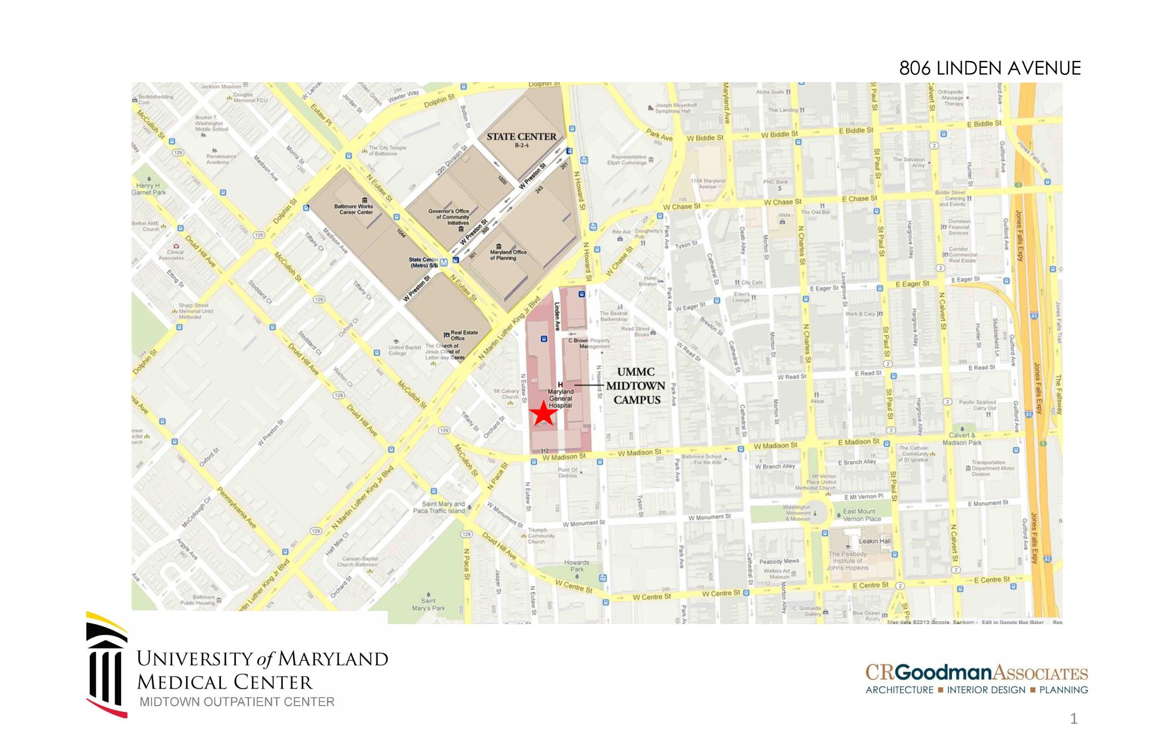

Slide 9
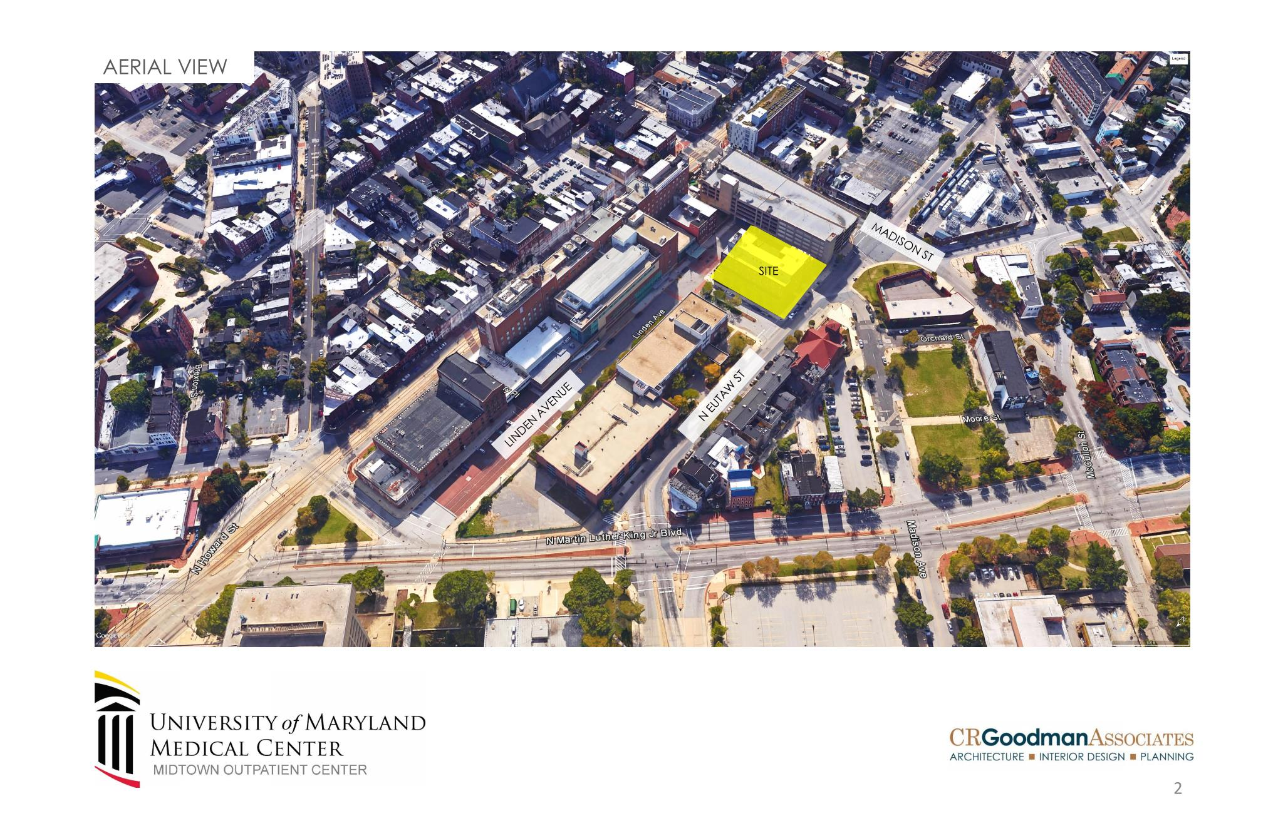

Slide 10
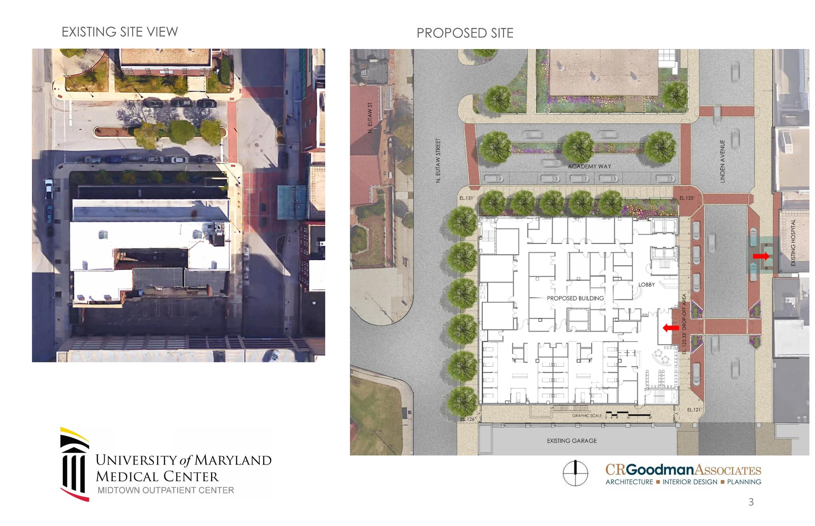

Slide 11
New Construction incorporates both
Clinical and Garage Expansion
Chronic Disease Mngt/Shell Space
Cardiology, Pulmonary, GI
Infectious Disease
Diabetes/Endocrinology
Garage
Ambulatory Surgery/Conf Center

Slide 12
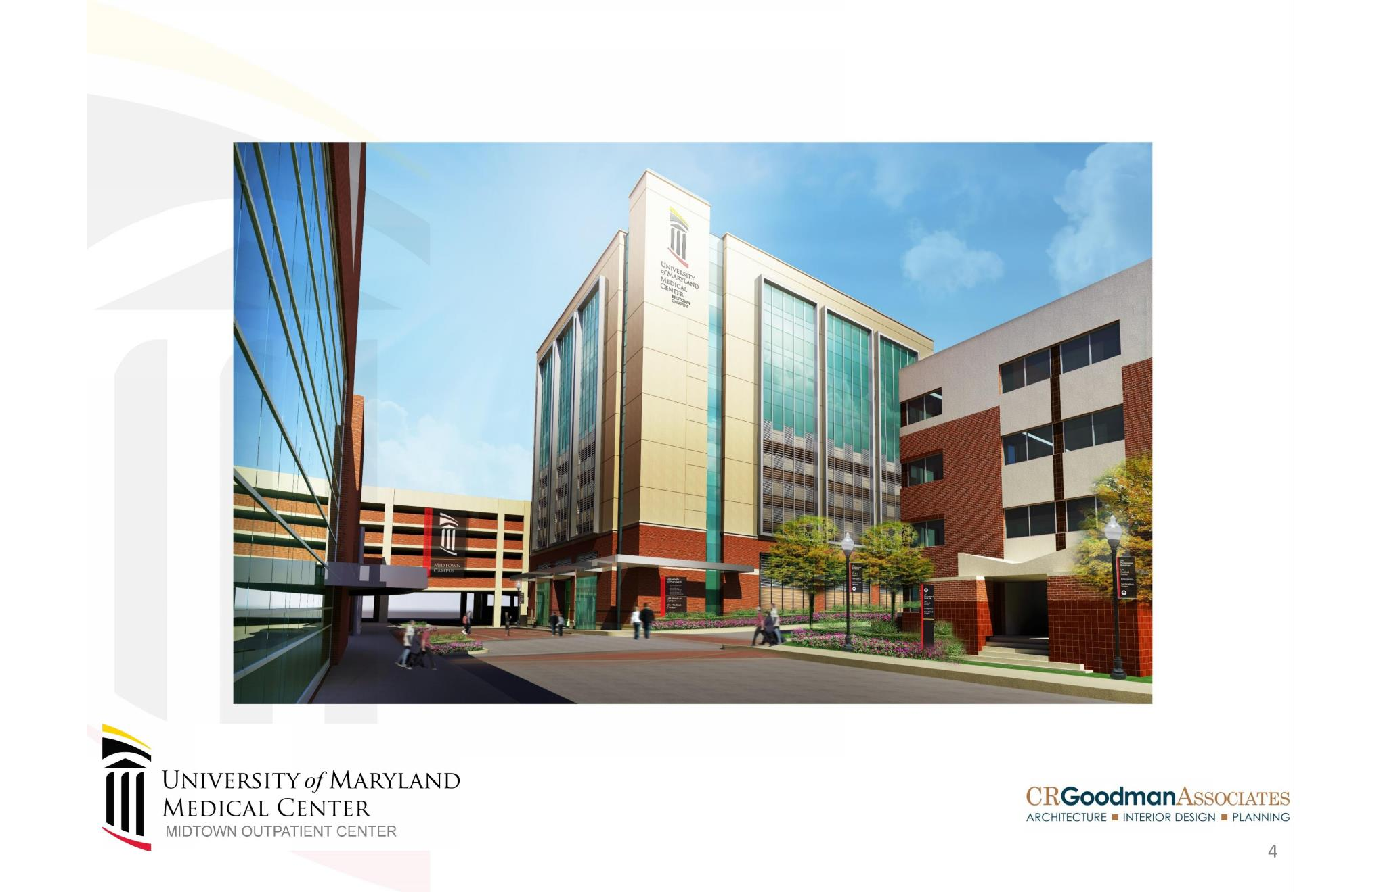

Slide 13
